Slide 1

Manuel Montoya Catalá Multimedia Information Management Carlos III University of Madrid May, 2015
Web Search using IR

Slide 2
Web Search using IR Manuel Montoya
Introduction
Web Crawling + HTML processing
IR System
Experiments and Evaluation
Conclusion
References
Notes:
The Web has millions of documents, we cannot perform classical information retrieval techniques on them, it takes too long, too many similarites.
They use techniques such as Indexing and Page Rang. Assign to every word combination, a list of ordered webs by relevance.
Constraint the number Webpages to a related area/s and perform better IR

Slide 3
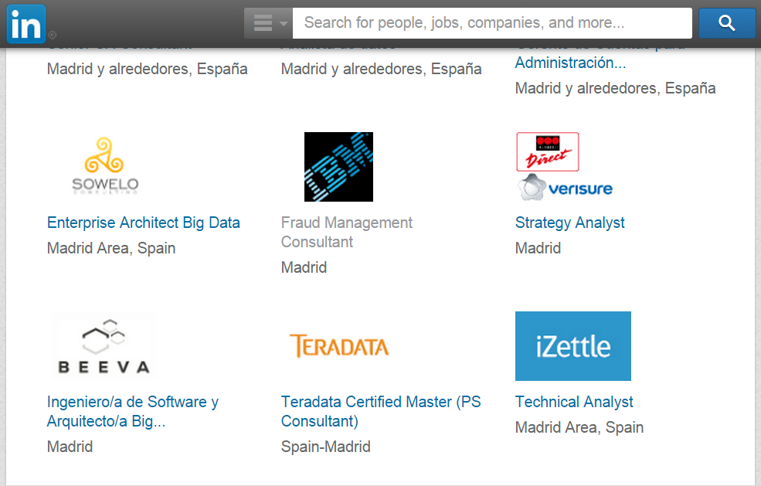

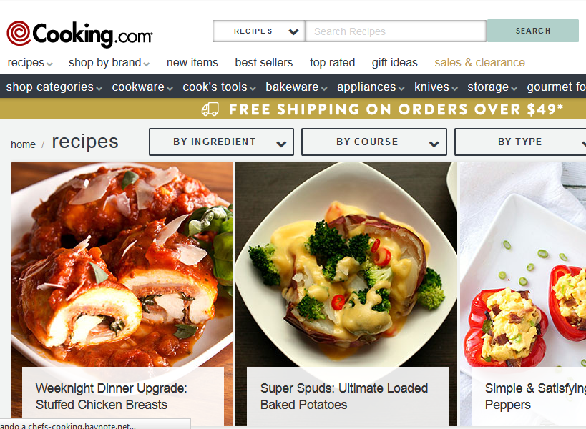
Web Search using IR Manuel Montoya
Introduction
The Internet
4,7 billion pages !!
Lots of Multimedia Data
Too many documents for performing classical Information Retrieval
Indexing and Page Rank
Specific web searchers just constraint the URL.
Constraint the document number
Specific topics
Perform better IR models
Allow Example Query
Notes:
The Web has become the largest available repository of data in the world.
We cannot perform classical information retrieval techniques on them, it takes too long, too many similarites.
Webbrowses use techniques such as Indexing and Page Rank. Assign to every word combination, a list of ordered webs by relevance.
Constraint the number Webpages to a related area/s and perform better IR

Slide 4
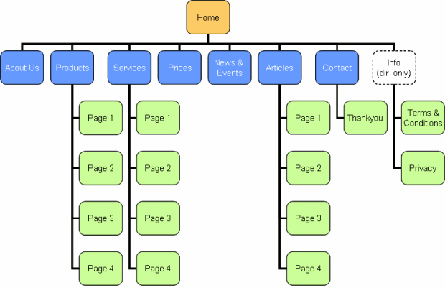
Web Search using IR Manuel Montoya
Metadata
Structure
Relevant Plain Text
Website
Spider
Document
corpus
IR
System
String Query Sample Query
The spider represents the main difference compared to traditional IR.
1. Page1
2. Page2
3. Page3
.
.
Ranked
Documents
Notes:
We use a Spider bot to download several WebSites (HTML documents).
Then preproces those documents to Get the relevant plain text, removing HTML markups, codes and non relevant texts.
We can also obtained metadata from them.
Perform TD-IDF for every HTML document.

Slide 5
Web Search using IR Manuel Montoya
Web Crawling + HTML processing
How do we download the Web pages ?
How do we obtain the:
Relevant text
Metadata
from the HTML documents?
Notes:
All hand-coded by scratch
All functions hand-coded by scratch.

Slide 6


Web Search using IR Manuel Montoya
Web Crawling
We must download our corpus from the Internet using a Spider or WebCrawler.
A Spider is a bot that:
Travels through WebPages downloading and procesing their content.
Parameters:
Starting URLs
Allowed domains
Link-following protocol
Rules for scraping.
Document Processing function.
Tried to code a Spider in Python !! Worked fair enough !
Not good enough for large scale downloads.
Ended up using the Scrapy framework.
Notes:
Used the URL library for the own-made spyder.

Slide 7
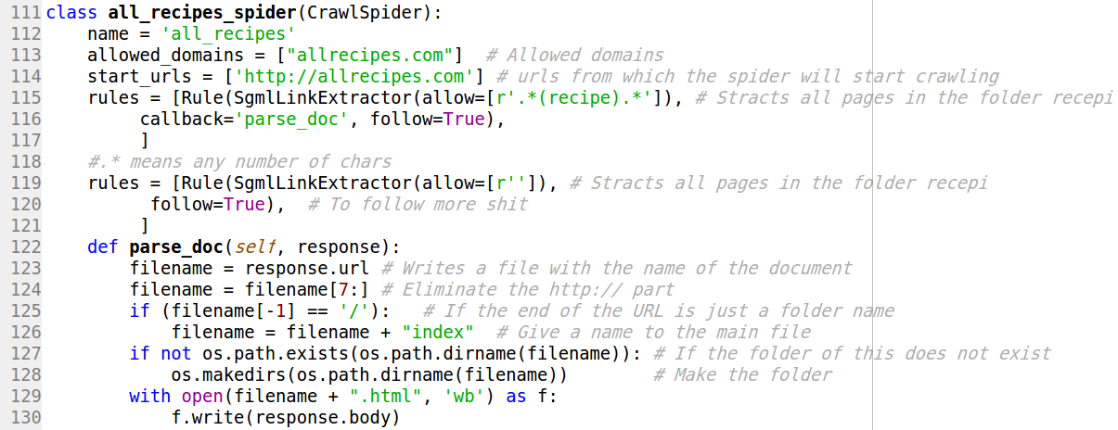
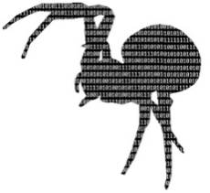
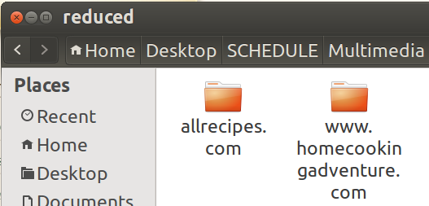
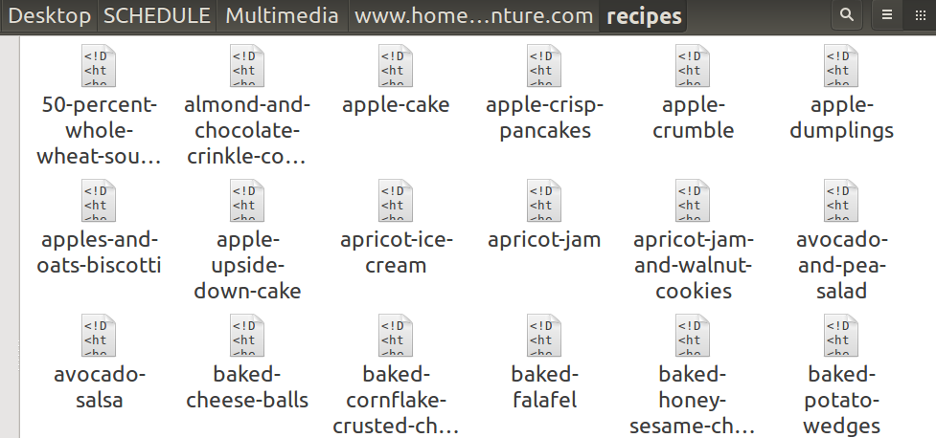
Web Search using IR Manuel Montoya
Web Crawling
Scrapy is a scraping and web crawling framework, used to crawl websites and extract structured data from their pages.
URL properties
Crawling Rules
Processing
Notes:
Difficulties: Learn Scrapy library, regular expressions (RegEx) for the rules, IO library for making files and directories. Some HMTL documents are not referenced by a document but by a folder, we need to add up a name.
Wanted to separate the downloading part from the Corpus Preprocessing Part
Example of a Crawler for Recipes.

Slide 8
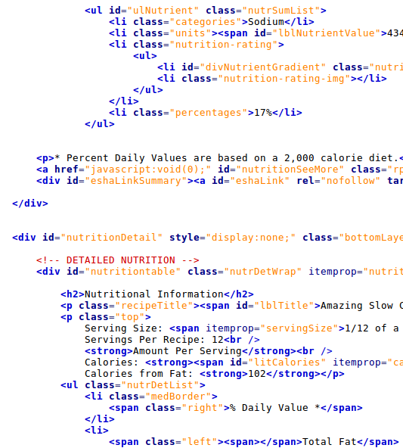
Web Search using IR Manuel Montoya
Corpus Preprocessing
Once we have folders structures containing HTML documents we have to:
Read all possible documents, need a «walker» program.
Remove non-recipe documents.
Remove near duplicates.
Due to JavaScript generating pages
An HTML document has:
Plain text.
HTML markups
Scripts: JavaScript, PHP…
Syles: CSS
Hyperlinks
We need to extract the relevant information:
Remove Scripts and Styles
Remove the markups.
Get Relevant text
Beautiful Soup !!
Notes:
We need to learn HTML in general and the specific structure of a particular website in order to get just the specific information we need.

Slide 9
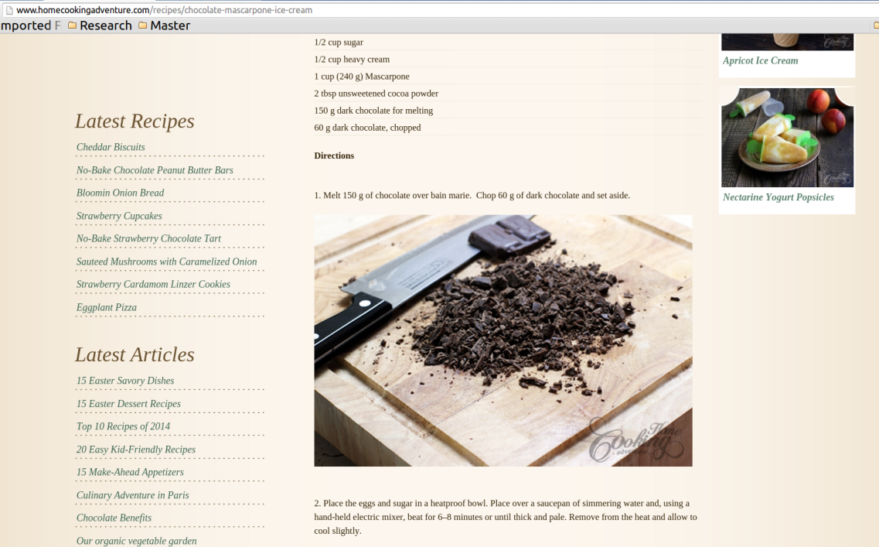
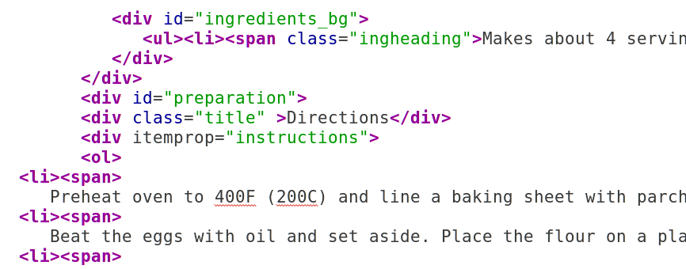
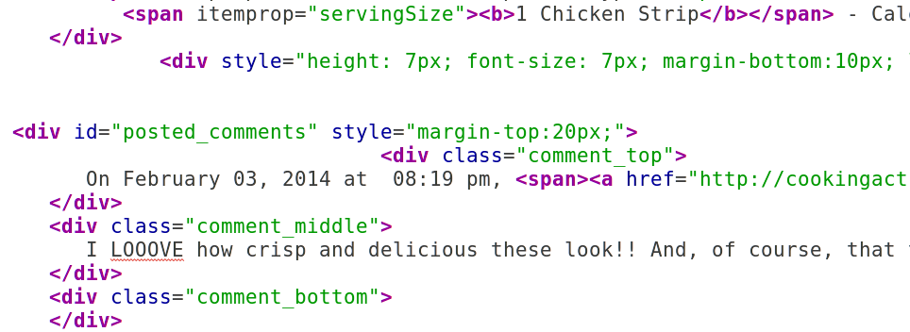
Web Search using IR Manuel Montoya
Corpus Preprocessing
BeautifulSoup library for HTML processing
Remove Scripts and Styles
Reference parts of the HTML
Get Plain texts
We still have to get our hands into the HTML code !!
Notes:
Delete missleading text such as comments and related recipes.
Each website has different ways of reference their elements and name them, so every website requiere.
Delete all hyperlinks if we don’t know the structure.

Slide 10
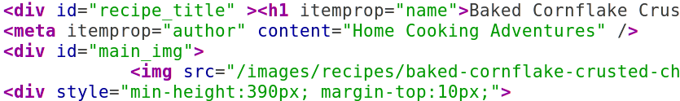
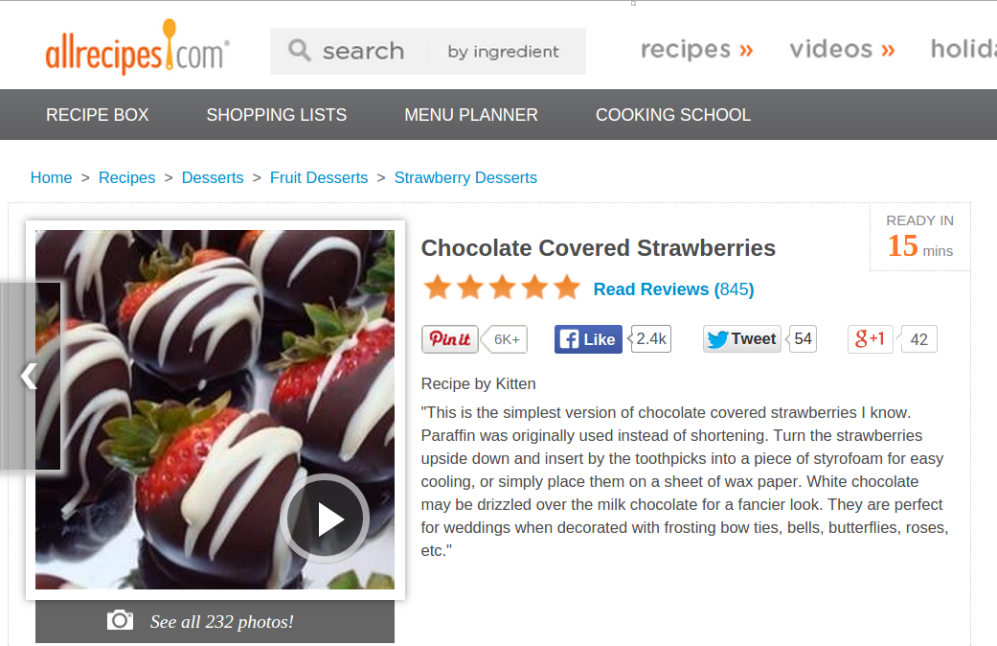
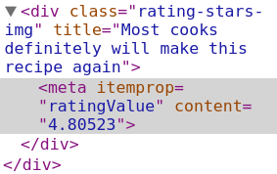
Web Search using IR Manuel Montoya
Corpus Preprocessing
Get Metadata Information for Ranking:
KeyWords
Ratings
Notes:
Get Metadata information that can have keywords that are more impotant.
Or ratings used for improving ranking or make Rule-based methods (If the ratings is below some threshold, don’t show them to me)
I bet you cannot do that with your browser humm ?
Also we need to store the URL as metadata.
Store into a file using pickle.

Slide 11
Web Search using IR Manuel Montoya
IR system
How do we preprocess the Plain text ?
Represent documents as an TF-IDF vector?
What Similarity Measures do you use ?
Notes:
All hand-coded by scratch
All functions hand-coded by scratch.

Slide 12
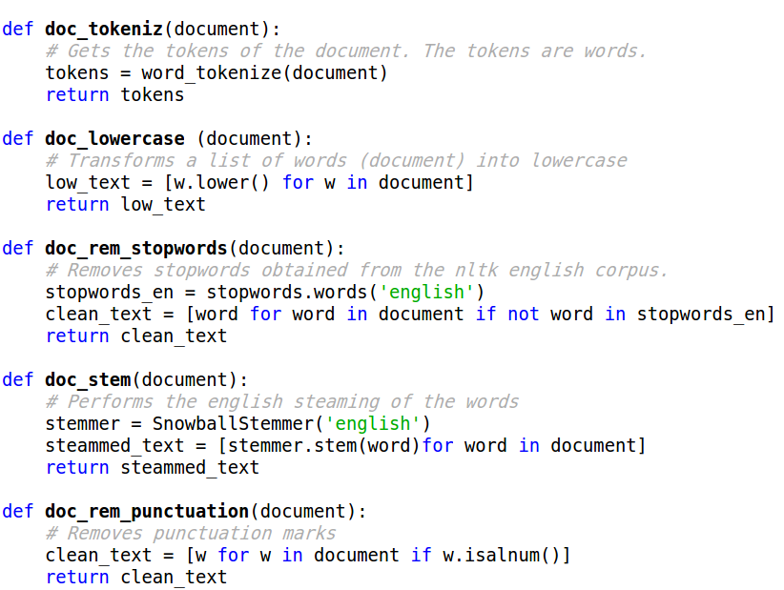
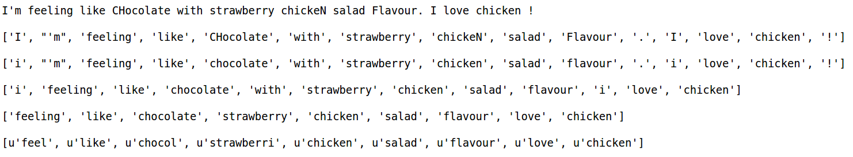
Web Search using IR Manuel Montoya
Text Preprocessing
Once we have relevant plain text, we use the NLTK Python library for preprocessing
Tokenization
Lower Case
Remove non-alphanumeric
Remove stopwords
Steamming (Snowball)
String Query !
Notes:
Tokenization: Divides the whole plain text String into separate String words.
Lower Case: Turns all letters to lower case so that they are not different. In this problem the upper letters are not relevant.
Remove non-alphanumeric: Punctuation marks, weird symbols.
Remove stopwords: Words that does not contain much information (the of in…) Used NLTK list.
Steamming: Normalize verbs, singulars and compositions so that they are the same.
In this procesdd we don’t delete duplicates because we want to calculate the frecuency term os words.

Slide 13
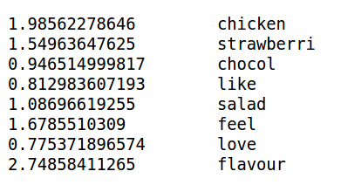
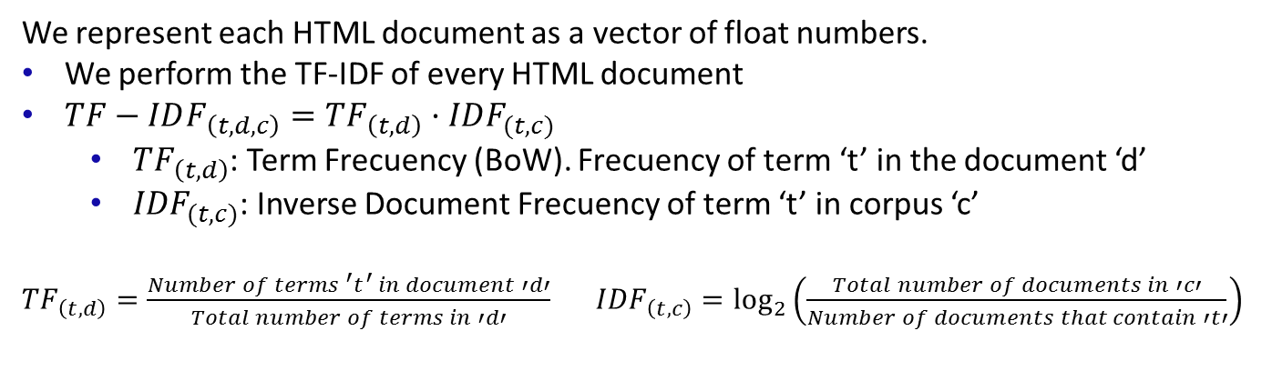
Web Search using IR Manuel Montoya
Vector Representation
We represent each HTML document as a vector of float numbers.
We perform the TF-IDF of every HTML document
$TF−IDF_{\left(t,d,c\right)}=TF_{\left(t,d\right)}·IDF_{(t,c)}$
${TF}_{\left(t,d\right)}$: Term Frecuency (BoW). Frecuency of term ‘t’ in the document ‘d’
${IDF}_{(t,c)}$: Inverse Document Frecuency of term ‘t’ in corpus ‘c’
${TF}_{\left(t,d\right)}=\frac{Number of terms {{}_{}^{′}t}^{′} in document ′d′}{Total number of terms in ′d′} {IDF}_{\left(t,c\right)}=\log_{2}\left(\frac{Total number of documents in ′c′}{Number of documents that contain ′t′}\right)$
String Query !
Ingredients
Description
Notes:
Some words like the ingredients are normal to have low salad IDF values. Strawberri has a bigger IDF value tan chocolate coz it appears less often (more significant)
Love and other words due to Description.
It has a surprising low value,
Which means a lot of people use it in their Descrition.
My mum has it, but it s not something you can buy at
A grocery shop.

Slide 14
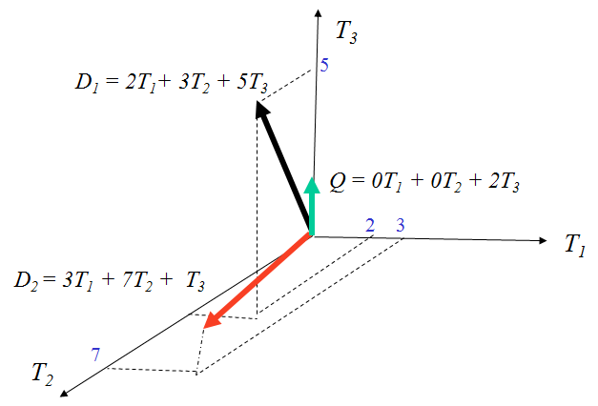
Web Search using IR Manuel Montoya
Similarity measures
Given a plain text Query D, we need to:
Get its TF-IDF vector.
Compare it with the whole corpus according to a Similarity Measure.
Programming Difficulty:
Every document has a different set of words
Need to find the words in commun and their associate TF-IDF values.
Similarity Measures:
Euclidean Distance
Cosine similarity
Good for Example Queries !
Bad for short String Queries and Keywords !

Slide 15
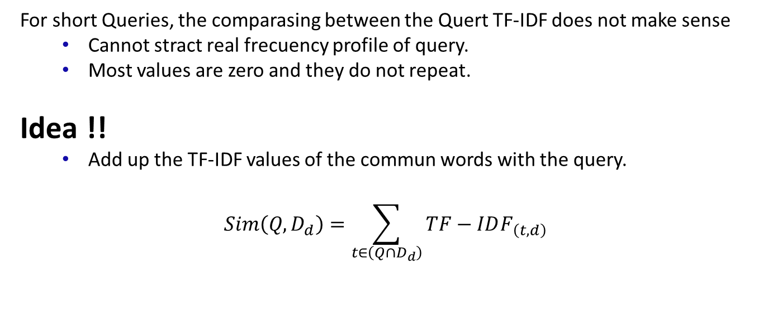
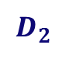

Web Search using IR Manuel Montoya
Simmilarity for short Queries
For short Queries, the comparasing between the Quert TF-IDF does not make sense
Cannot stract real frecuency profile of query.
Most values are zero and they do not repeat.
Idea !!
Add up the TF-IDF values of the commun words with the query.
$$Sim\left(Q,D_{d}\right)=\sum_{t∈\left(Q∩D_{d}\right)}^{ }{TF−IDF_{\left(t,d\right)}}$$
$$D_{1}$$
$$D_{2}$$
Notes:
This simmilarity measure takes into account

Slide 16
Web Search using IR Manuel Montoya
Ranking
The BEST similarity measure depends on the properties of the query:
´
For Example Queries:
Average ranking of Ecuclidean Distance + Cosine Distance rankings
For String Queries:
Sum of the TFIDF values of the common words.
For keywords:
Number of words in commun.
For Stars Ranking:
Rule-Based Constraint
Notes:
This simmilarity measure takes into account

Slide 17
Web Search using IR Manuel Montoya
Experiments and Results
What is your Corpus made of ?
Are your Results any Good?
What Similarity Measures do you use ?
Notes:
All hand-coded by scratch
All functions hand-coded by scratch.

Slide 18
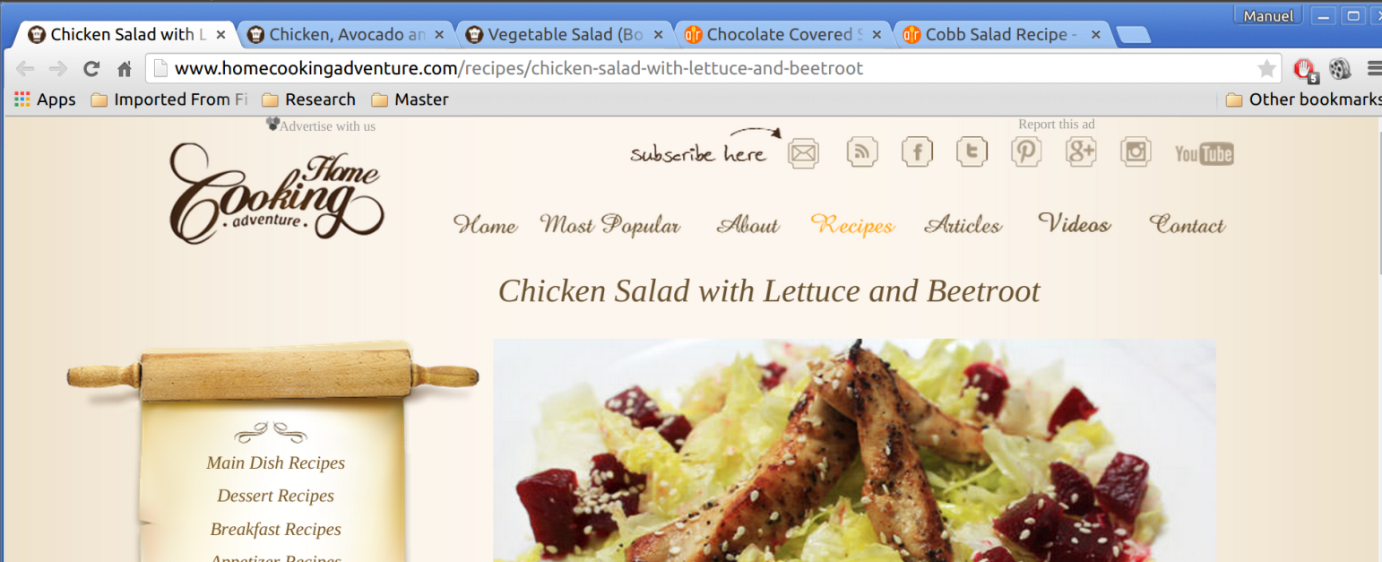
Web Search using IR Manuel Montoya
Experiments
Corpus of about 1000 recipes !! Not too big to avoid very close recipes !
www.homecookingadventure.com
allrecipes.com
System accepts:
Plain text queries
URLs as a query. It downloads and preprocess the HTML document.
The System then opens up a browser with the top 5/10/20… recipes !!
Using the «webbrowser» library
Notes:
Example Query and String Query.
Tell story about getting different similar results every time with the example query.
But… it’s a deterministic function !!
Webpages change parts of their content every time… so it changed the query.

Slide 19
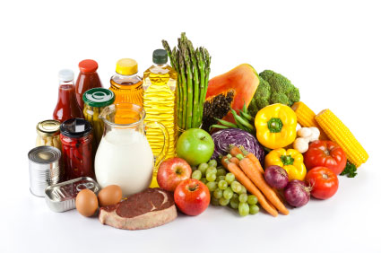
Web Search using IR Manuel Montoya
Demonstration Time !
Give me some ingredients !
Try to be nice !
Notes:
Example Query and String Query

Slide 20
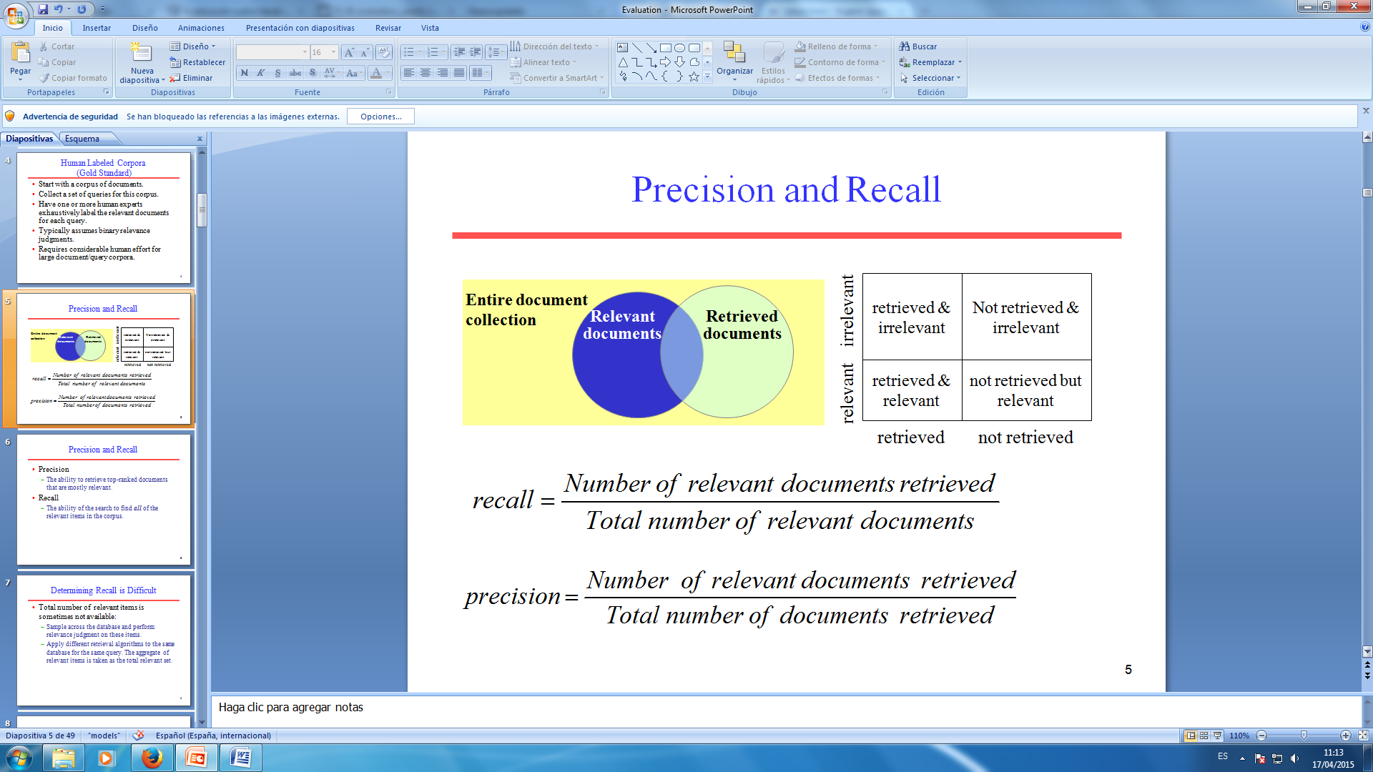
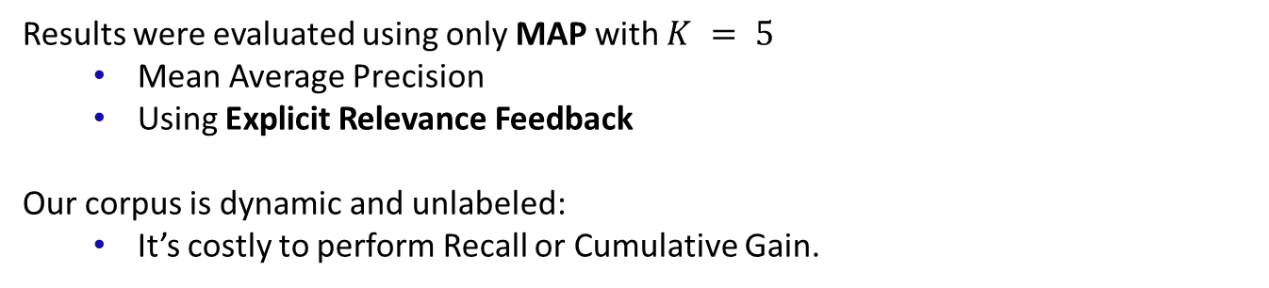
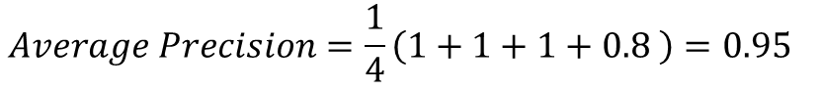
Web Search using IR Manuel Montoya
Results and Evaluation
Results were evaluated using only MAP with $K = 5$
Mean Average Precision
Using Explicit Relevance Feedback
Our corpus is dynamic and unlabeled:
It’s costly to perform Recall or Cumulative Gain.
$$Precisiont at document t= \frac{Number of relevant pages retrieved}{Total number of pages retrieved}$$
On average they follow this structure:
$$Average Precision=\frac{1}{4}\left(1+1+1+0.8 \right)=0.95$$
Notes:
Finally, once we have finished our system in order to evaluate its performance, we will use Precision.
We didn’t not and Recall since our Corpus is dynamic and unlabeled, it is very costly to get this parameter.
Also didn’t do Cummulative Gain because it was also difficult to label.

Slide 21
Web Search using IR Manuel Montoya
Conclusions
You can make your own specific corpus !!
About anything you want !
In one single day !
For FREE !
The System:
Retrives good HTML documents.
Performs more accuarate Web searchs than Google jejej
Constrains the search using specific inner web data
Can use example queries.
Notes:
Finally, once we have finished our system in order to evaluate its performance, we will use Precision and Recall which are the basic measures used to evaluate the performance of information retrieval systems.

Slide 22
Web Search using IR Manuel Montoya
References
[1]
Brants, Thorsten. "Natural Language Processing in Information Retrieval." CLIN. 2003.
[2]
WU, Ho Chung, et al. Interpreting tf-idf term weights as making relevance decisions. ACM Transactions on Information Systems (TOIS), 2008, vol. 26, no 3, p. 13.
[3]
D. Jurafsky, C. Manning. “Natural Language Processing”. By Standford.
Coursera: https://class.coursera.org/nlp/lecture
[4]
Broder, Andrei. "A taxonomy of web search." ACM Sigir forum. Vol. 36. No. 2. ACM, 2002.
[5]
Mansourian, Yazdan. "Similarities and differences between web search procedure and searching in the pre-web information retrieval systems." Webology 1.1 (2004).
[6]
Langville, Amy N., and Carl D. Meyer. "Information retrieval and web search." Supported by National Science Foundation under NSF grant CCR-0318575, USA (2006).

Slide 23
Web Search using IR Manuel Montoya
Thank you !!

